Slide 1

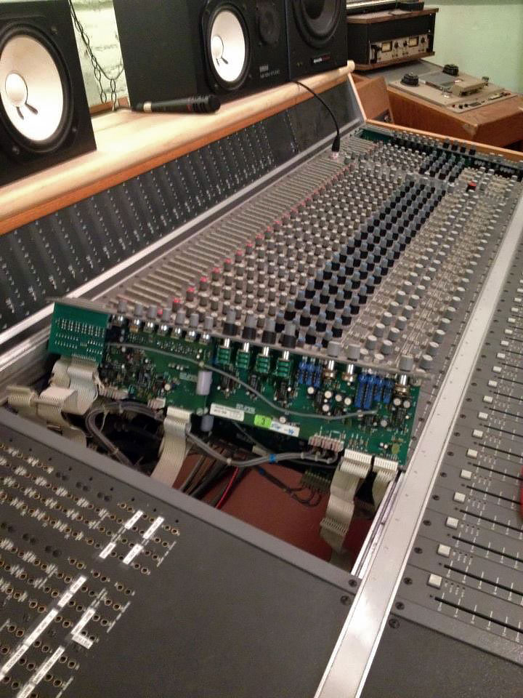
ExEx Audio
Site rebuild

Slide 2
Objectives
• A portfolio site
• Hip, current look
• Flatter the space in photos
• Effective point of contact
• Google results

Slide 3
Clients
• Owned and run by two audio engineers
• Placeholder site of poor quality
• Artists
• Sophisticated aesthetic taste
• No web design skills

Slide 4
Competition
• Competitor sites generally very poor
• Easy to stand out online

Slide 5
Target Audience
• Much like client
• Young artists, bands, creatives etc.
• Responsive to hip, tight visual design
• Internet savvy
• Low income
• Place high value on ExEx’s services

Slide 6
Challenges
• Difficult to photograph
• Design visual UX for auditory medium

Slide 7
What I learned
• An overview of what a team looks like
• My job in pro audio had no teams
• Dividing labor tasks
• Job titles, descriptions and attributes
• Workflow and its importance

Slide 8
What I’d do differently
• More prep for design, dimensions etc.
• Study more sites beforehand
• Get more information from client

Slide 9
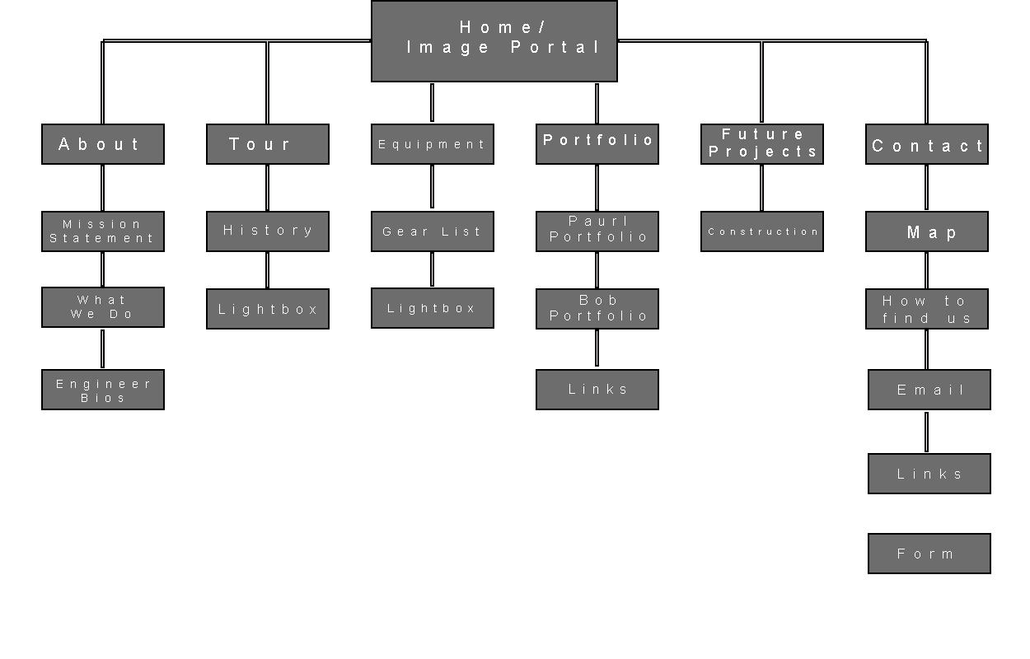

Slide 10
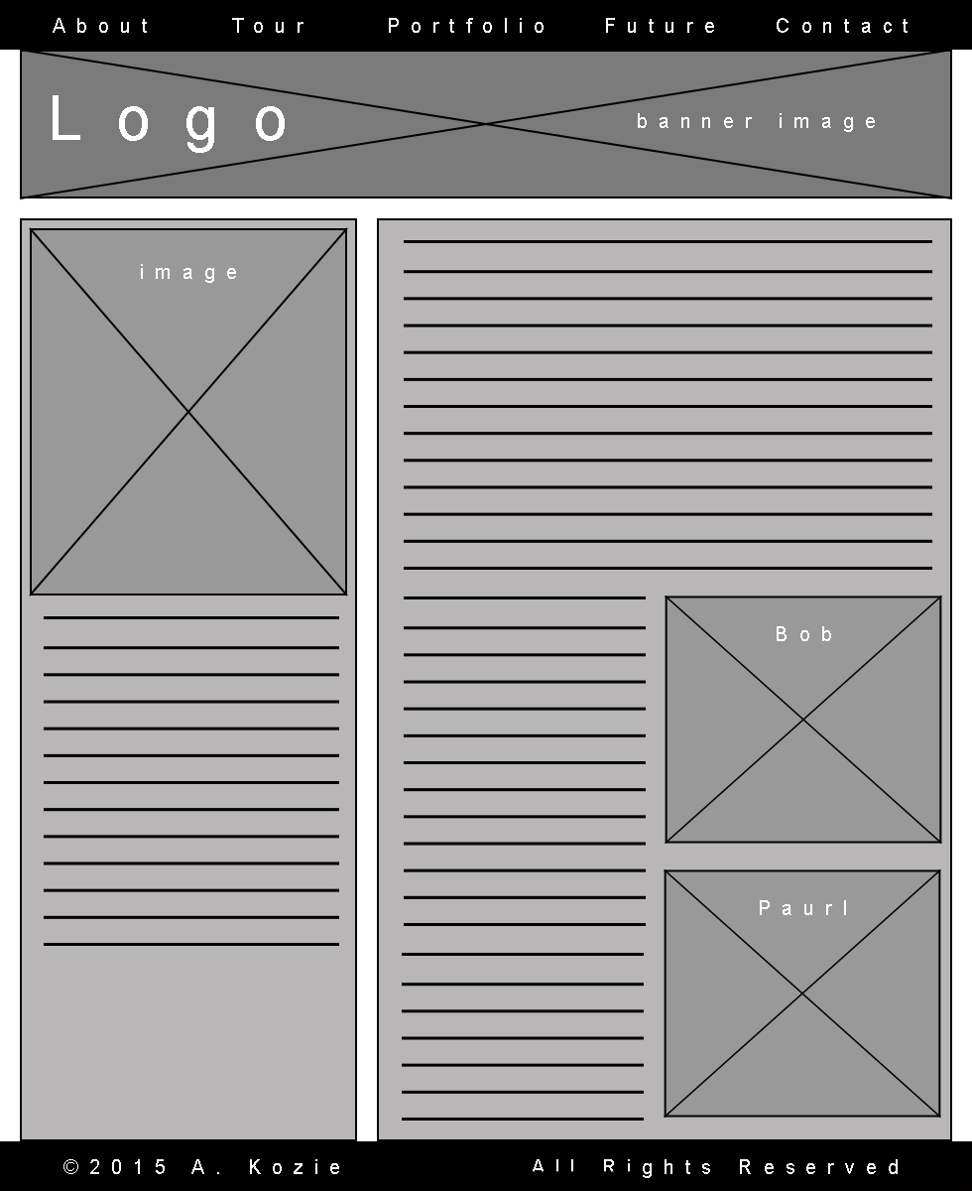


Slide 11
URL
tinyurl.com/zuh6hdx

